Slide 1

PRESENTATION ON
SEARCH ENGINE OPTIMISATION (SEO)
Rupesh Shah [Technical Director]
Barodaweb – The E-Catalogue Designer
Mobile : 9824091021
Email : rupesh@barodaweb.net

Slide 2


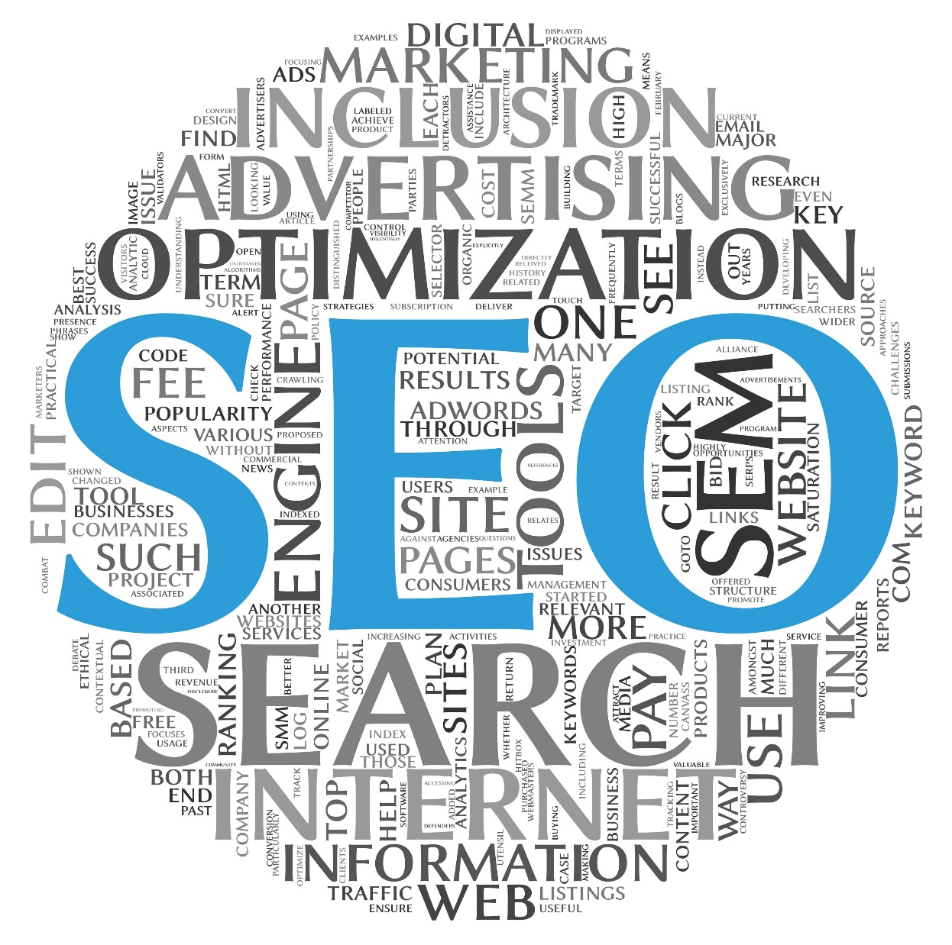

Slide 3
What is SEO ?
SEO
(Search Engine Optimization):
Search Engine Optimization / Search Engine Marketing is the process of making a site and its content highly relevant for both search engines and searchers. Successful search marketing helps a site gain top positioning for relevant words and phrases.

Slide 4
Key Internet Marketing Strategies
Search Engine Optimization (SEO) - No Cost Per Click
Search Engine Marketing (SEM) - Cost Per Click

Slide 5
How do organic search listings work ?
A spider or crawler which is a component of a SE gathers listings by automatically "crawling" the web.
The spider follows links to web pages, makes copies of the pages and stores them in the SE’s index.
Based on this data, the SE then indexes the pages and ranks the websites
Major SEs that index pages using spiders: Google, Yahoo, AltaVista, MSN, AOL, Lycos

Slide 6
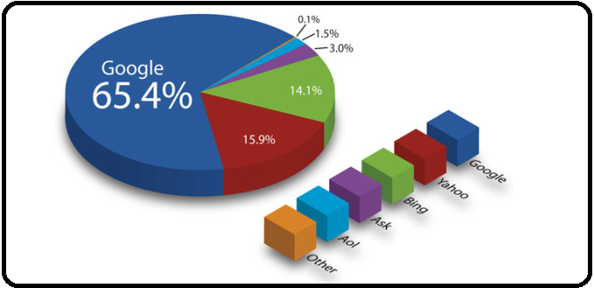
TOP Search Engines and Uses

Slide 7
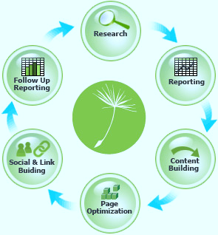
Search Engine Optimization (SEO) Process
Research
Reporting & Goal Setting
Content Building
Page Optimization
Social & Link Building
Follow Up Reporting & Analysis

Slide 8
Research
SEO Process | Description
Keyword Research | Keyword phrase research involves identifying a group of keyword phrases that will be used in optimization.
Competitive Research | We do a thorough competitive analysis of the subject site against its biggest competitors. We use a series of SEO metrics, including indexed content, Alexa rating, inbound links, domain age, and social media following among others.

Slide 9
Reporting & Goal Setting
Description
It is important to understand what the subjects site’s starting position is within the search engines.
Doing so ensure that you know the specific areas that need work and provides a baseline against which to gauge the subsequent campaigns success.
Access to site traffic information is very important. These statistics show how searches are finding and interacting with the subject site.

Slide 10
Content Building
Description
Content is king in search engine optimization.
The search engine love text; high volume, high-quality content related to your business will serve you in a couple of important ways.

Slide 11
Page Optimization
Description
Page Title | Make sure that your site’s page titles say something other than just your company name or welcome
Text-based navigation | Search engines cannot read image. If your site’s navigation system is done with images (lots are). You will need a text-based navigation system that the search engines can follow to ensure that all the important services and product-related sub pages of your site are indexed by the search engines.
Prominence of targeted keyword phases | It is not enough to have your keyword phrase(s) somewhere on the web page, the placement and prominence given to them also affects your search engine placement.
Site Map | Developing a site map that includes a well-organized list of links to all the important pages of your site and includes a text link to the site map on your home page is the ideal way to make sure that all the site’s pages are indexed by the search engines.
ALT and META data | These are tags not seen by the site’s users; they are embedded in the site’s code. ALT tags refer to the text that describe an image – word that you see popup as you mouse over some images.
Clean up the Code | Navigation rollover script, other JavaScript based code, and all CSS scripts should be taken out of the code of each page and put into external files to which each page of the site is referenced.

Slide 12
Social & Link Building
Description
Social Media | The power of online sharing though social media provides tremendous opportunities for companies willing to commit the time to using it.
Building in-bound links | Each new, quality link to your site increase the likelihood of both the search engines spiders running across your site as well as searches looking for services or product like yours.

Slide 13
Follow Up Reporting & Analysis
Description
The same reporting done in the initial phase of the campaign is done again at regular intervals, post-optimization
Ranking, site traffic and other key metrics can then be compared to pre-optimization levels, giving measurable result to the SEO campaign.
The specific metric used in an SEO plan will depend on the goals of the site.

Slide 14
SEO - What is NOT Recommended
Flash and shockwave - spiders do not pick up these files
Image only sites - spiders do not pick up images
Image maps - spiders cannot read image maps.
Do not use them on your home page or critical pages.
Frames - only one page can be titled (titling is critical in search rankings)
- If the spider cannot read the complete page (because of the frames), it will not be indexed properly.
- Some spiders may not even read a frames web site
Password protected pages – spiders cannot enter password protected pages

Slide 15
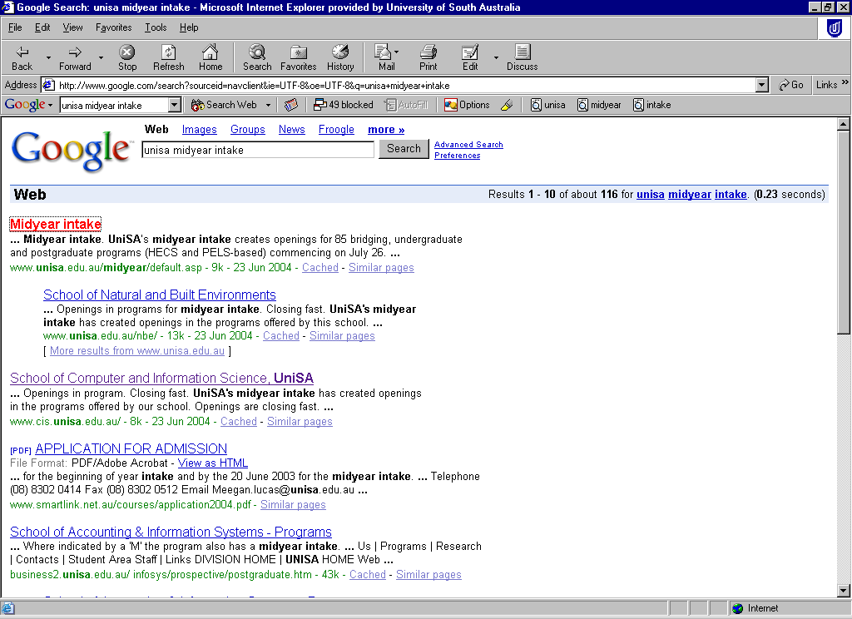
How SEO Elements Affect Organic Listings
Title Tag
Meta description tag (or first para of text if no meta des has been added)
Keywords

Slide 16
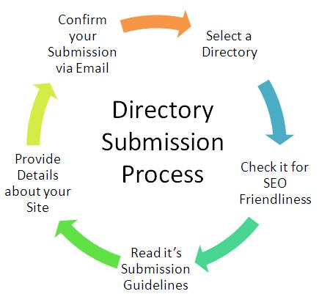
Directory Submission
Our Directory Submission service is the best way to create a large number of one way links. Manual and relevant submissions by our experts ensure high percentage of approvals. In order to create an effective presence on the internet, you must have the link of your website in as many venues as possible. Directory submission is an effective way to ensure this. Link Building is one of the most relevant steps for the website marketing and directory submission is an irreplaceable part of this process.
How does Directory Submission work?
As the internet grows, the number of websites is also increasing at record speed. According to some estimates, at least 200 new websites are launched every day, around the world. Obviously, this incessant growth needed some structure and frame. Internet experts felt that there should be some way to categorize the websites to make it easier for user to search websites. Hence, website directories were born. These directories allow users to search website in various categories. Users or website owners can log in to these web directories and post links of websites after choosing a suitable category. It’s an easy to use, and highly effective tool.

Slide 17
Benefits of Directory Submission:
Incoming Links: Each directory submission creates an incoming link for the website. This not only increases the link popularity of the website, but also increases its search engine ranking, as search engines count the number of one-way links to a website while determining its ranking in the search results. The more incoming links a website has, the higher will be its ranking. Hence, its extremely helpful in your effort to get your website in top 20 search results.
More Traffic: Many internet users search web directories to find good websites on various topics, especially those users who are looking for a specific service or products provided. This traffic can be diverted towards the websites which have submitted the links to these directories.
Permanent Links: Once a link is approved by a directory submission, it becomes its permanent part of the directory. The directory moderators don’t do any changes or deletion in those links.
Internal page popularity: Most web directories also allow deep links i.e. links of the pages other than home-page of the website. This ensures that your entire website gets equal chances of getting good number of visitors.
Brand visibility: The first rule of any kind of promotional campaign, offline or online, is to stay in the eyes of its targeted customers. Directory submission is an excellent way to do it.
Increase in profits: The improved traffic, due to directory submission, might lead to an increase in the sales of products and services. This is an excellent way to improve sales on your website.

Slide 18

Article Directory Submission
Article Directory Submission is one of the most popular ways to get huge traffic as well as high quality one way backlink to your site/blog.
5 Web 2.0/Blog postings(Using pre-written articles)
Web 2.0 is online communication that utilizes platforms that facilitate online sharing and interaction. Tools like blogs, podcasts and message boards are common Web 2.0 platforms.

Slide 19
Blog
A blog is a web-based journal or collection of dated comments on a subject. A classroom blog can be maintained by a teacher and used to dispense information for students and parents. A classroom blog can also be used as a Content Management System, aggregating the written work of students, who write in their own blogs, which are maintained in the classroom or teacher blog. Blogs can also be syndicated, meaning students and/or parents can use a web-based reader, such as a Google Reader, to follow a particular blog.
Social Bookmarking
Social Bookmarking Submissions
Social bookmarking is a powerful tool in promoting a website. But going through all of those social bookmarking sites is very time-consuming and downloading all toolbars is madness.

Slide 20
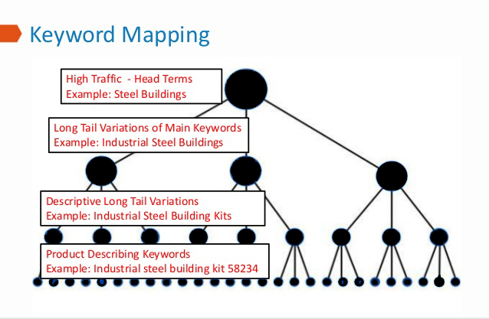
Keywords Research & Keywords Mapping
Keyword research improves search engine optimization only when it’s used to change the content on a site. The process of transforming a spreadsheet of data into optimized content can be bewildering without a process, however.
Every page on a site needs to have its own unique keyword target so that the site can target as many relevant keywords and drive the most organic search as possible.
Keyword research can yield hundreds of thousands of potential keywords to target. The keyword map is the bridge between keywords and content, and the tool that ensures that keywords are used most optimally across the entire site.

Slide 21
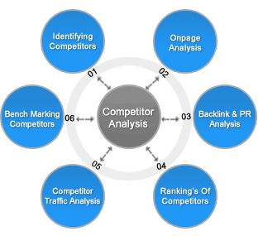
Competitor Analysis
In formulating business strategy, managers must consider the strategies of the firm's competitors. While in highly fragmented commodity industries the moves of any single competitor may be less important, in concentrated industries competitor analysis becomes a vital part of strategic planning.
Competitor analysis has two primary activities, 1) obtaining information about important competitors, and 2) using that information to predict competitor behavior. The goal of competitor analysis is to understand:
with which competitors to compete,
competitors' strategies and planned actions,
how competitors might react to a firm's actions,
how to influence competitor behavior to the firm's own advantage.

Slide 22
HTML Sitemap & XML Site Map Setup
Sitemaps are a protocol that allows the webmaster for a website to inform Google and other major search engines about URLS on a website that are available for crawling. Sitemaps allow search engines to find all of your webpages, that they might otherwise miss when indexing. The XML sitemap allows you to specify additional information about each URL such as:
When it was last updated
How often the site changes
How important the page is in relation to other pages on the site
An HTML sitemap allows site visitors to easily navigate a website. It is a bulleted outline text version of the site navigation. The anchor text displayed in the outline is linked to the page it references. Site visitors can go to the Sitemap to locate a topic they are unable to find by searching the site or navigating through the site menus.
Why do you need a Sitemap
Because it allows to inform Search Engines about important pages on your website. That increases its visibility to Google, Bing, Yahoo, Baidu, Yandex etc, and ensures indexing of the web pages that might not be discovered otherwise. Those provide additional information about your site to searching engines, complementing their traditional methods of crawling the World Wide Web. All major search engines use the same XML-based protocol for that. This means that having an XML Sitemap will let Google, Yahoo, Microsoft's Bing (MSN), and Ask have up-to-date information any time you upload a new map file to your server.

Slide 23
SEO Process By Diagram
Step : 1
SEO Process
Keyword Research
Onsite Optimization
Content Optimization
Link Building
Analysis & Evolution
Reputation Management
Website Analysis

Slide 24
Website Analysis
Data Gathering
Existing Traffic Analysis
Best Landing Pages
Competitor Research
Targeted Keyword
Current Ranking
Best Performing Page
Backlink Discovery
Step : 2

Slide 25
Keyword Research
Brainstorming Keyword Ideas
MDK Keywords
Trends
Ranking Keyword
Webmaster Tools
Social Mentions
Other Ranking Tools
Manual Checking
Data Gathering
Google Keyword Tool
Wordtracker
SEOmoz Tools
Step : 3

Slide 26
Onsite Optimization
Website Architecture
Navigation
Internal Linking
Content
Duplicate Content Issues
URL Structure
Phrase
Quality
HTML & Technical Issues
Titles, Tags, Alt’s
Crawlability & Accessibility
Site Speed
Sitemaps
Step : 4

Slide 27
Content Optimization
Title, Tags & Keywords
Converting Meta Description
Landing Pages With Call to Action
Internal Linking
Easy Sharing
Step : 5

Slide 28
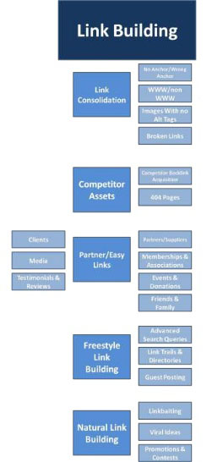

Slide 29

Barodaweb

